Slide 1


Implementation of Robotic Arm using MATLAB & Simulink
Bangalore Institute of Technology
K.R. Road, V V Puram, Bangalore-560004
Department of Electronics and Communication Engineering
MINI-PROJECT PRESENTATION
Under the guidance of:
Presented by
Guide Name: Dr.SREE RANGA RAJU M N
Designation: Professor
Dept. of ECE,BIT.
Name: H P Jeevan USN:1BI18EC051
Name: G Rohith USN:1BI18EC045
Name: Emyl Varghese George USN:1BI18EC044

Slide 2
INSTITUTE VISION AND MISSION
Vision: To establish and develop the Institute as the Centre of higher learning, ever abreast with expanding horizon of knowledge in the ﬁeld of Engineering and Technology with entrepreneurial thinking, leadership excellence for life-long success and solve societal problems.
Mission: 1: Provide high quality education in the Engineering disciplines from the undergraduate through doctoral levels with creative academic and professional programs.
2: Develop the Institute as a leader in Science, Engineering, Technology, Management and Research and apply knowledge for the beneﬁt of society.
3: Establish mutual beneﬁcial partnerships with Industry, Alumni, Local, State and Central Governments by Public Service Assistance and Collaborative Research.
4: Inculcate personality development through sports, cultural and extracurricular activities and engage in the social, economic and professional challenges.
Bangalore Institute of Technology
Dept. of ECE, BIT

Slide 3
DEPARTMENT VISION , MISSION, PEOs, PSOs
Vision: Imparting Quality Education to achieve Academic Excellence in Electronics and Communication Engineering for Global Competent Engineers.
Mission: 1.Create state of art infrastructure for quality education.
2. Nurture innovative concepts and problem solving skills.
3. Delivering Professional Engineers to meet the societal needs.
PEOs: 1. Prepare graduates to be professionals, Practicing engineers and entrepreneurs in the field of Electronics and communication engineering.
2. To acquire sufficient knowledge base for innovative techniques in design and development of tools and systems.
3. Capable of competing globally in multidisciplinary field.
4. Achieve personal and professional success with awareness and commitment to ethical and social responsibilities as an individual as well as a team.
5. Graduates will maintain and improve technical competence through continuous learning process.
PSOs: PSO1: The graduates will be able to apply the principles of Electronics and Communication in core areas.
PSO2: An ability to use latest hardware and software tools in Electronics and Communication engineering.
PSO3: Preparing Graduates to satisfy industrial needs and pursue higher studies with social-awareness and universal moral values.
Bangalore Institute of Technology
Dept. of ECE, BIT

Slide 4
Course Outcomes of Mini-Project
1 | Ability to carry-out literature review and define the problem.
2 | Ability to co-ordinate to work as a team member or a single member.
3 | Inculcate methods to use advance tools .
4 | Design analytical modeling and develop a systems
5 | Ability to equip analysis skills and interpretation.
6 | Enhance presentation skills, drafting and documentation of project work.
CO-PO Mapping Table
PO CO | 1 | 2 | 3 | 4 | 5 | 6 | 7 | 8 | 9 | 10 | 11 | 12 | PSO 1 | PSO 2 | PSO 3
1 | 3 | 2 | 2 |  |  | 1 |  | 1 | 1 | 1 |  |  | 2 | 2
2 | 3 | 2 | 2 |  |  | 1 |  | 1 | 1 | 1 |  |  | 2 | 2
3 | 3 | 2 | 2 |  | 3 |  |  | 1 | 1 | 1 |  |  | 2 | 2
4 | 3 | 2 | 2 |  | 3 | 1 |  | 1 | 1 | 1 |  |  | 2 | 2
5 | 3 | 2 | 2 |  | 3 | 1 |  | 1 | 1 | 1 |  |  | 2 | 2
6 | 3 |  |  |  | 3 |  |  | 1 | 1 | 1 | 2 |  | 2 | 2
Bangalore Institute of Technology
Dept. of ECE, BIT

Slide 5
CONTENTS
S. No. | Topic | Slide no.
1. | Abstract | 6
2. | Introduction | 7
3. | Literature Survey | 8-9
4. | Objectives | 10
5. | Methodology | 11-12
6. | Implementation & Design | 13-19
7. | Results & Observations | 20-23
8. | Conclusion | 24
9. | Future Work | 25
10. | References | 26-27
Bangalore Institute of Technology
Dept. of ECE, BIT

Slide 6
ABSTRACT
Robotics has been acknowledged as a mainstay in the industrial automation domain for decades. The use of industrial robots is increasing in areas such as food, consumer goods, wood, plastics and electronics, but is still mostly concentrated in the automotive industry. It is gradually making its headway into the domain of military, medical and vehicle applications. The main idea behind the functioning of a robotic arm is that it imitates the actions of a human arm.
In this project we deal with the design and control of a robotic arm with 3 degrees of freedom using 5 servo motors. It is mainly made of three joints, two grippers, three links and a rectangular base. The two types of grippers that have been designed are mechanical gripper and an electromagnetic gripper. The grippers are used to take the desired object from one position and carry it to a desired position. Our model is simulated using MATLAB and then realized in a Hardware Implementation using Arduino Uno which is controlled by a Simulink model.
Bangalore Institute of Technology
Dept. of ECE, BIT

Slide 7
INTRODUCTION
The purpose of designing a mechanical robotic arm is to simulate the actions and movement capabilities of a human arm. Robotic arms are constructed with multiple beams connected by special types of hinges. For a mechanism to be classified as a mechanical arm, it must be able to grab and hold an object, and transfer it to a new location.
A common term that’s used when a robot arm is designed is DOF (degrees of freedom). The configuration of a robot is a complete specification of the position of every point of the robot. The minimum number of real-valued coordinates needed to represent the configuration is the number of degrees of freedom of the robot. The n-dimensional space containing all possible configurations of the robot is called the configuration space (C-space).
There are several factors we must consider when constructing a robot arm, including the maximum load weight, the torques of each one of the servos, how much weight each servo must support related to its position in the arm, and the weight of each frame that constitutes the arm.
The robotic arm described in this project moves through the set waypoints which are defined by the user in order to transfer an object to the desired location. The advantage of this automated process results is faster completion time with minimum errors.
Bangalore Institute of Technology
Dept. of ECE, BIT

Slide 8
LITERATURE SURVEY
A survey on Arduino Controlled Robotic Arm by Ankur Bhargava:
In this paper, a 5 Degree of Freedom (DOF) robotic arm has been developed. It is controlled by an Arduino Uno microcontroller which accepts input signals from a user by means of a set of potentiometers. The arm is made from four rotary joints and end effector also, where rotary motion is provided by a servomotor. The servo-motors and links thus produced assembled with fasteners produced the final shape of the arm. The Arduino has been programmed to provide rotation to each servo motor corresponding to the amount of rotation of the potentiometer shaft. A robot can be defined according to the nature of the relative movements between the links that constitute it.
Survey on Design and Development of competitive low cost Robot Arm With Four Degrees of Freedom by Ashraf Elfasahany:
In this paper, the representation of the design, development and implementation of robot arm is done, which has the ability to perform simple tasks, such as light material handling. The robotic arm is designed and made from acrylic material where servo motors are used to perform links between arms. However, the rotation range of the motor is less than 180º span, which greatly decreases the region reached by the arm and the possible positions. This design of the robot arm was for four degrees of freedom.
Design and Fabrication of Pick and Place Robot to be used in Library by Anusha Ronanki, M. Kranthi:
The use of robots in library is becoming more popular in recent years. The trend seems to continue as long as the robotics technology meets diverse and challenging needs in educational purpose. RFID is used for identifying the books and it has two IR Sensors for detecting the path.
Bangalore Institute of Technology
Dept. of ECE, BIT

Slide 9
LITERATURE SURVEY
This robot is about 4 kg in weight and it is capable of picking and placing a book of weight one kg.
Pick and Place Robotic Arm Implementation Using Arduino Ashly Baby , Chinnu Augustine, Chinnu Thampi, Maria George , Abhilash A P ,Philip C Jose:
A robotic arm is designed using Arduino to pick and place the objects via user commands. It will pick and place an object from source to destination safely. The soft catching gripper used in the arm will not apply any extra pressure on the objects. The robot is controlled using android based
smart phones through Bluetooth. Based on the commands given by the user the robot moves accordingly. At the receiver end there are four motors interfaced with the micro controller.
As discussed in the above papers, most of the robotic arms are controlled manually by the use of potentiometers or by using gesture control mechanisms which may lead to inaccurate results. Also, the speed of the motion of the robotic arm is low. In our project, we have tried to remove manual intervention and have automated the process. The movement of the arm is faster, therefore repetitive tasks can be done quickly in order to save time. Due to this reason we get more accurate movement of the robotic arm, thus it can be used in precision-driven applications such as in medical surgeries, 3D printing and welding. Most of the models mentioned use a mechanical gripper but we have introduced an electromagnetic gripper which is better to handle metallic objects.
Bangalore Institute of Technology
Dept. of ECE, BIT

Slide 10
OBJECTIVES
To simulate a virtual model of the 3R-robotic arm using MATLAB.
To design a control mechanism which can be used to move to a given position.
To implement an algorithm to move through a given set of waypoints.
To generate trajectory for motion planning.
To implement a hardware model of the robotic arm using Arduino.
Add a gripper to the end effector to pick and place an object.
To build a completely automated robotic arm.
Bangalore Institute of Technology
Dept. of ECE, BIT

Slide 11
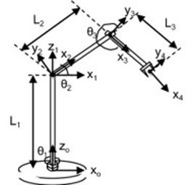
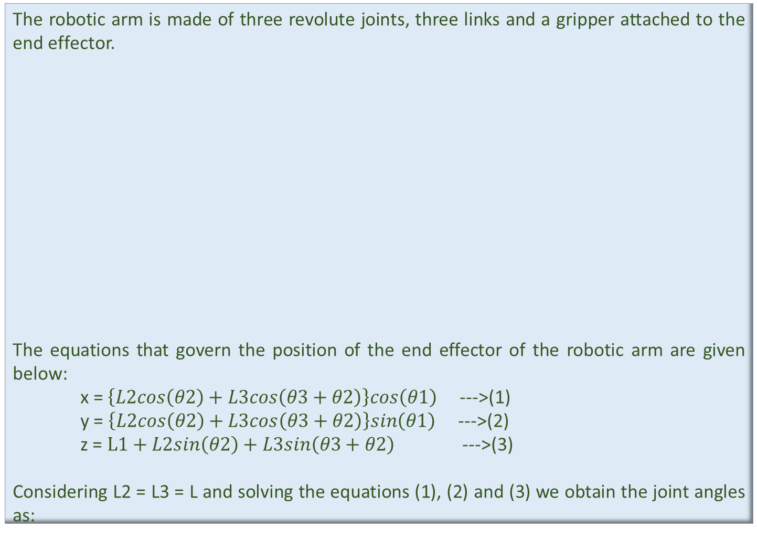
METHODOLOGY
The robotic arm is made of three revolute joints, three links and a gripper attached to the end effector.
The equations that govern the position of the end effector of the robotic arm are given below:
x = $\left\{L2cos\left(θ2\right)+L3cos\left(θ3+θ2\right)\right\}cos\left(θ1\right)$ --->(1)
y = $\left\{L2cos\left(θ2\right)+L3cos\left(θ3+θ2\right)\right\}sin\left(θ1\right)$ --->(2)
z = $L1+L2sin\left(θ2\right)+L3sin\left(θ3+θ2\right)$ --->(3)
Considering L2 = L3 = L and solving the equations (1), (2) and (3) we obtain the joint angles as:
In reference to Figure 1:
L1, L2, L3 = the link lengths
θ1, θ2, θ3 = the joint angles
x, y, z = position of the end effector
Figure 1: Schematic of robotic arm
Bangalore Institute of Technology
Dept. of ECE, BIT

Slide 12
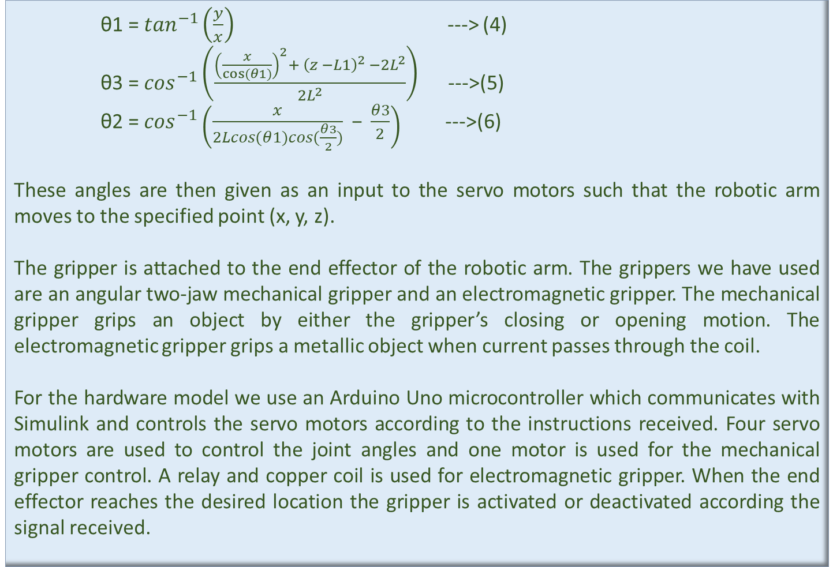
METHODOLOGY
θ1 = $\tan^{−1}\left(\frac{y}{x}\right)$ ---> (4)
θ3 = $\cos^{−1}\left(\frac{{\left(\frac{x}{cos⁡(θ1)}\right)}^{2}+ {\left(z −L1\right)}^{2} −{2L}^{2}}{{2L}^{2}}\right)$ --->(5)
θ2 = $\cos^{−1}\left(\frac{x}{2Lcos(θ1)cos(\frac{θ3}{2})}\text{ − }\frac{θ3}{2}\right)$ --->(6)
These angles are then given as an input to the servo motors such that the robotic arm moves to the specified point (x, y, z).
The gripper is attached to the end effector of the robotic arm. The grippers we have used are an angular two-jaw mechanical gripper and an electromagnetic gripper. The mechanical gripper grips an object by either the gripper’s closing or opening motion. The electromagnetic gripper grips a metallic object when current passes through the coil.
For the hardware model we use an Arduino Uno microcontroller which communicates with Simulink and controls the servo motors according to the instructions received. Four servo motors are used to control the joint angles and one motor is used for the mechanical gripper control. A relay and copper coil is used for electromagnetic gripper. When the end effector reaches the desired location the gripper is activated or deactivated according the signal received.
Bangalore Institute of Technology
Dept. of ECE, BIT

Slide 13
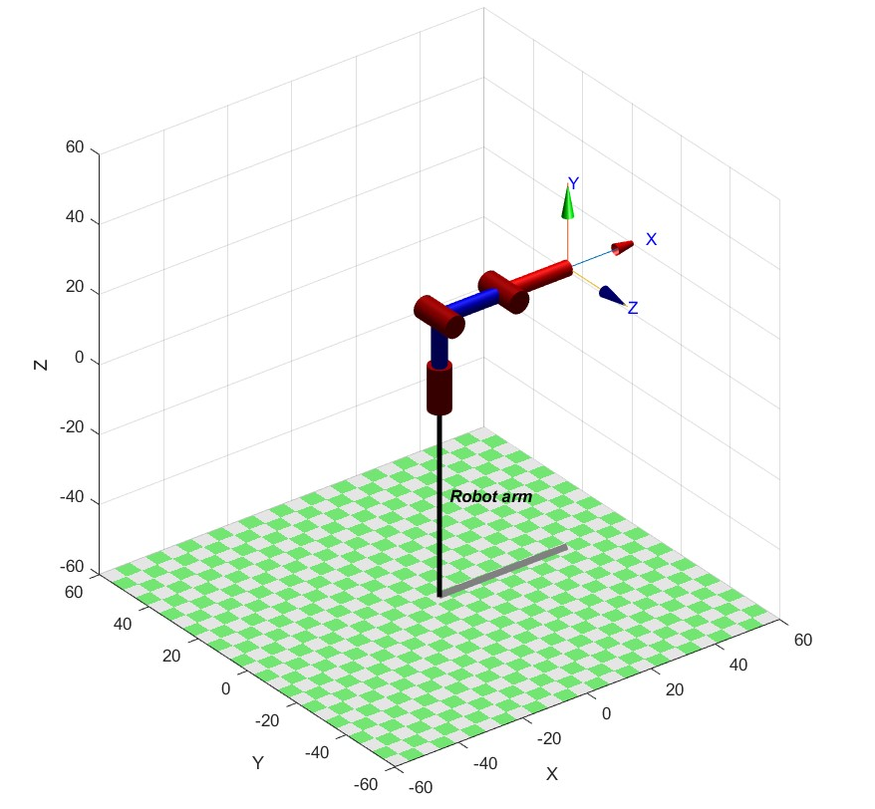
IMPLEMENTATION & DESIGN
SIMULATION:
We have created a serial link robotic arm using the Robotic Toolbox designed by Peter Corke. Figure 2 shows an image of the simulated model.
In order to obtain a smooth trajectory, we have defined constant angular velocities for all the joint angles in the simulation.
Figure 2: Simulated model
Bangalore Institute of Technology
Dept. of ECE, BIT

Slide 14
IMPLEMENTATION & DESIGN
The following functions have been implemented to achieve our robot arm's motion:
get_position():
Gets the position based on the current joint angles of the robot.
Inputs: joint angle, link length
Outputs: x, y, z
get_angles():
Gets the joint angles based on the desired position of end effector.
Inputs: desired position, link length
Outputs: new joint angle, is animate
get_trajectory():
Gets the trajectory points based on the waypoints.
Inputs: new joint angle, joint angle, angular velocity
Output: traj points
animate():
Animates the robot model.
Inputs: Rob, traj points
repeat_motion():
Repeats the motion between specified waypoints.
Inputs: waypoints, joint angle, link length, angular velocity
Outputs: traj points, is animate
Bangalore Institute of Technology
Dept. of ECE, BIT

Slide 15
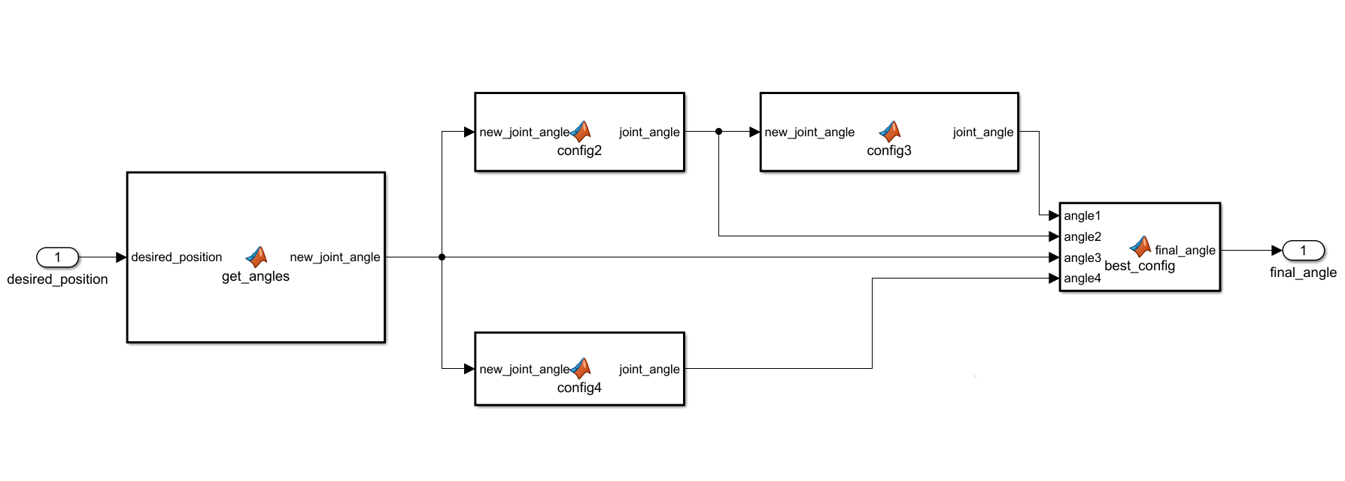
IMPLEMENTATION & DESIGN
HARDWARE IMPLEMENTATION USING SIMULINK:
Figure 3 shows the subsystem “get_joint_angles” which is used to get the different joint angle configurations that the robot arm can reach for a given waypoint. The “get_angles function is used to get one of the four joint angle configurations. Based on this the other functions contained in the subsystem output the remaining configurations. The “best_config” function then selects the joint angle which can be implemented on the hardware model.
Figure 3: Get joint angles subsystem
Bangalore Institute of Technology
Dept. of ECE, BIT

Slide 16
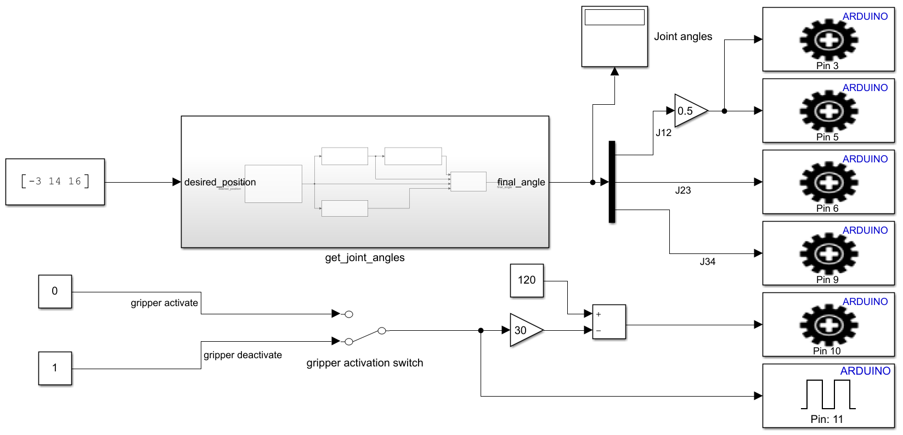
IMPLEMENTATION & DESIGN
In this model, the desired position is given to the subsystem “get_joint_angles” which gives the required joint angles. If the position cannot be reached then and the arm is reset to initial position. These angles are provided to the servo motors connected to the Arduino and the robotic arm moves to the desired position. The grippers are controlled using a manual switch.
Figure 4: Simulink model to move the robotic arm to desired position with gripper
Bangalore Institute of Technology
Dept. of ECE, BIT

Slide 17
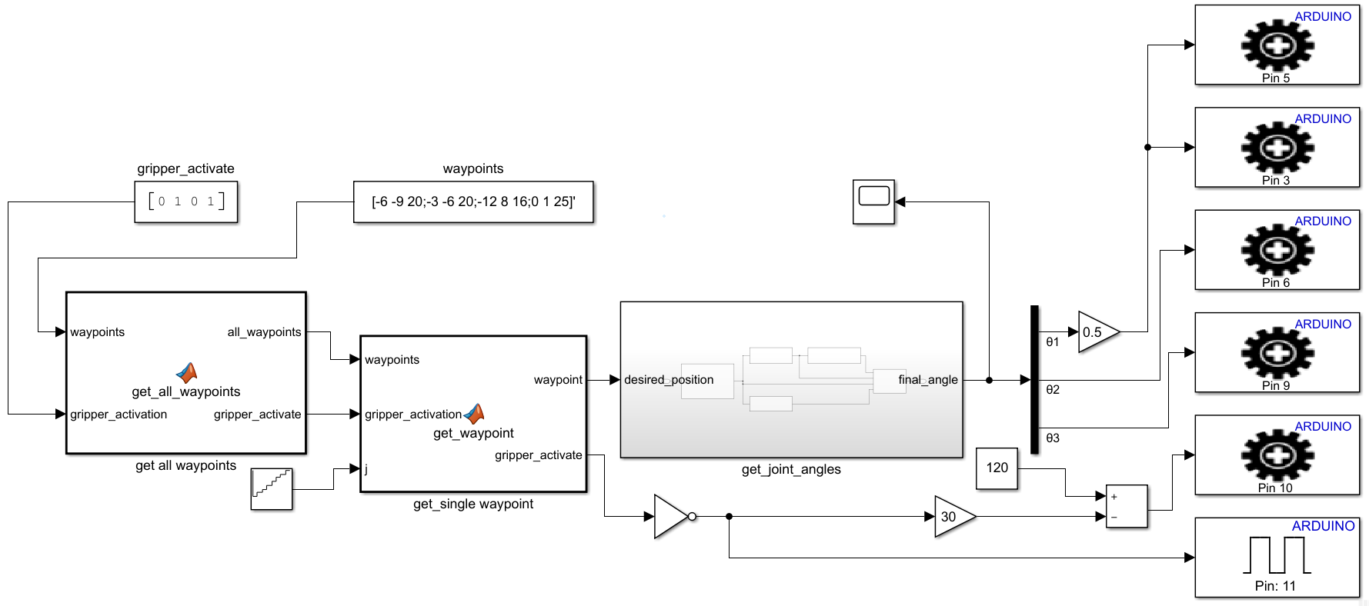
IMPLEMENTATION & DESIGN
Figure 5 shows the control mechanism of a fully automated robotic arm. In this model, the waypoints and the gripper status at each waypoint are provided as inputs to the function “get_all_waypoints” which combines them to give a better representation of waypoints and gripper activation. Each waypoint is extracted from “get_waypoint” and fed into “get_joint_angles” subsystem which gives the required joint angles. These commands are provided to Arduino which controls the servos and relay.
Figure 5: Simulink model to move the robotic arm through a set trajectory
Bangalore Institute of Technology
Dept. of ECE, BIT

Slide 18
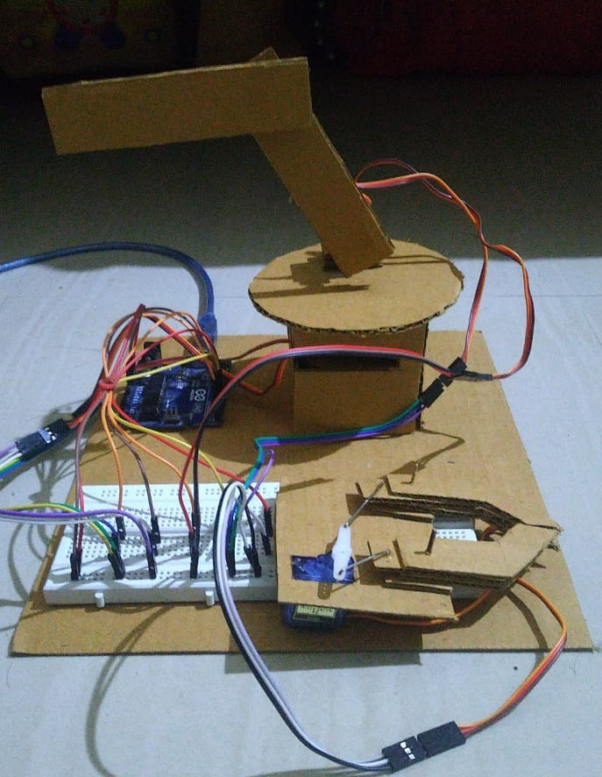
IMPLEMENTATION & DESIGN
DESIGN OF HARDWARE:
Body Material: Cardboard
Electronic components: Arduino Uno, Relay module, Servo motor (Tower Pro SG-90), Breadboard, Jumper and Copper wires.
SPECIFICATIONS:
Link lengths:
L1 = 10cm
L2 = 8cm
L3 = 8cm
Joint angles ranges:
θ1 = [0, 360]
θ2 = [0, 180]
θ3 = [0, 180]
θ4 = 90, 120 for mechanical gripper
Figure 6: Hardware model
Bangalore Institute of Technology
Dept. of ECE, BIT

Slide 19
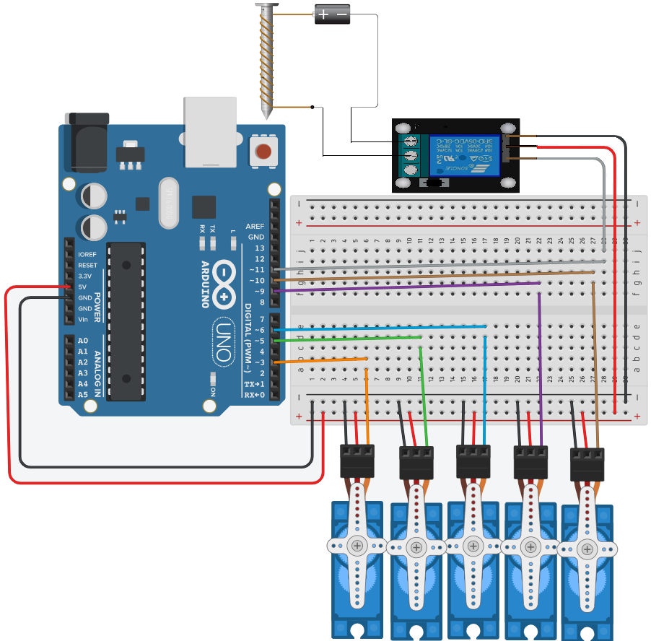
IMPLEMENTATION & DESIGN
CIRCUIT DIAGRAM:
Figure 7 shows the connections between the servos, relay and the Arduino:
Servo 1 → Pin 3
Servo 2 → Pin 5
Servo 3 → Pin 6
Servo 4 → Pin 9
Servo 5 → Pin 10
Relay i/p → Pin 11
Here,
Servo 1 and Servo 2 control θ1, Servo 3 controls θ2,
Servo 4 controls θ3,
Servo 5 controls θ4.
Relay controls electromagnetic gripper
Figure 7: Circuit diagram
Bangalore Institute of Technology
Dept. of ECE, BIT

Slide 20
OBSERVATIONS
SIMULATION:
Initially, the robotic arm is at the point [16, 0, 10] where the joint angles are [0 0 0]. For the desired point given as x = -7cm, y = 12cm and z = 11cm the joint angles are generated as θ1 = 120 deg, θ2 = -26 deg and θ3 = 58 deg.
Based on the initial and final joint angles 28 trajectory points are generated. The trajectory points are defined evenly based on constant angular velocities w1 = 0.008 rad/s, w2 = 0.004 rad/s and w3 = 0.004 rad/s.
It has been observed that the robot arm is moving through the waypoints and at the end the simulated arm has reached desired position.
When the desired position is given as x = 40cm, y = 30cm and z = 40cm that is out of the range of the of the robotic arm it is reset to its initial position.
The waypoints [6 12 10;-7 12 11;-2 12 11;15 1 10] and number of iterations is given as 3 and 63 trajectory points were generated based on the same angular velocities as given above.
It has been observed that the robot arm moves through the waypoints when these trajectory points were provided and the robot arm repeats the motion three times.
Bangalore Institute of Technology
Dept. of ECE, BIT

Slide 21
OBSERVATIONS
HARDWARE IMPLEMENTATION:
The following joint angles are given as input to the servos based on the desired position:
It can be observed that from Table 1 that the points 1, 2, 3, 4, and 6 can be reached and thus valid joint angles have been generated. Position 5 cannot be reached, therefore we get the joint angles as 0, 90, 90 and the arm resets itself. The grippers are activated when the manual switch is turned on.
Sl.No. | X (in cm) | Y (in cm) | Z (in cm) | Θ1 (in deg) | Θ2 (in deg) | Θ3 (in deg)
1. | 6 | 12 | 10 | 62 | 56 | 156
2. | -7 | 12 | 11 | 120 | 64 | 148
3. | -2 | 12 | 11 | 98 | 54 | 170
4. | 15 | 1 | 10 | 2 | 69 | 130
5. | -13 | 17 | 14 | 0 | 90 | 90
6. | 13 | 1 | 11 | 4 | 59 | 160
Table 1: Position and corresponding joint angles
Bangalore Institute of Technology
Dept. of ECE, BIT

Slide 22
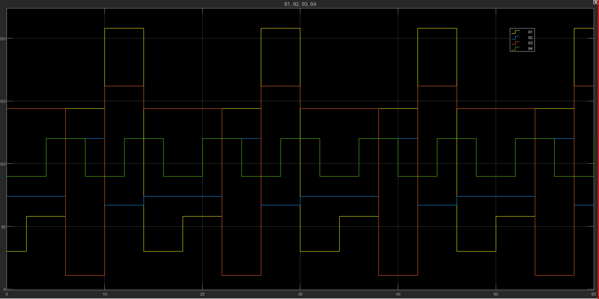
OBSERVATIONS
The joint angles generated can be seen in Figure 8 which are periodic in nature and change their values based on the waypoints. The gripper is activated at appropriate waypoints.
Figure 8: Joint angles θ1, θ2, θ3 and θ4
Bangalore Institute of Technology
Dept. of ECE, BIT

Slide 23
RESULTS
We have simulated and verified the virtual model of the 3R-robotic arm which goes through the desired waypoints using MATLAB.
We have implemented a hardware model of the robotic arm and have added two grippers.
We have completely automated the process of gripper activation and moving it through several waypoints.
Bangalore Institute of Technology
Dept. of ECE, BIT

Slide 24
CONCLUSION
Overall, the objectives of this project have been achieved which are developing the hardware and software for robotic arm, implementing the pick and place system operation and also testing the robot that meets the purpose of the project.
The robot has been developed successfully and the movement of the robot is controlled using Simulink. This robot is expected to overcome tasks such as picking and placing objects.
Design, manufacturing and analysis of robotic arm has been successfully completed. It is concluded that this robotic arm is working properly under the specified working envelope with good accuracy. It is successfully able to carry defined objects by the use of both grippers. The mechanical grippers can be used for pick and place operation required in assembly line which will be helpful to increase productivity. The electromagnetic grippers can be used in industries working with metallic objects.
During the process of making and developing the project, we have learnt Arduino, MATLAB and Simulink and how to interface between them. This knowledge has been put into practice and it has been ensured that it is suitable for the purpose of the project.
Bangalore Institute of Technology
Dept. of ECE, BIT

Slide 25
FUTURE WORK
Increasing the degrees of freedom of the robot arm.
Increase the accuracy of movement of the robot.
Building different grippers for appropriate tasks.
Change open loop control to closed loop control by the use of sensors.
Building a more diverse model using techniques such as object recognition and color sensing.
Installing the robotic arm on a rover to make it mobile.
Bangalore Institute of Technology
Dept. of ECE, BIT

Slide 26
REFERENCES
Robotic toolbox, MATLAB robotics toolbox by Peter Corke used for the simulation: https://www.petercorke.com/RTB/r9/html/SerialLink.html
Yang Shen Ph.D. Candidate, Bionics Lab, UCLA MAE 263B. Introduction to Robotics Toolbox for MATLAB: http://bionics.seas.ucla.edu/education/MAE_263D/RTB_MATLAB_Intro.pdf
ROBOMECHTRIX, Forward Kinematics | Puma560 | Peter Corke Toolbox https://www.youtube.com/watch?v=jFfUDp2Hh5w
Robotics Toolbox for MATLAB® Release 10, Peter Corke https://petercorke.com/wp-admin/adminajax.php?juwpfisadmin=false&action=wpfd&task=file.download&wpfd_category_id=27&wpfd_file_id=1050&token=&preview=1
Ge Creative, How To Make Arduino Robotic Arm Controlled with Smartphone - Cardboard DIY https://www.youtube.com/watch?v=zs_keUVE26A&t=337s
Bangalore Institute of Technology
Dept. of ECE, BIT

Slide 27
REFERENCES
Simulink Support Package for Arduino Hardware by MathWorks Simulink Team: https://www.mathworks.com/matlabcentral/fileexchange/40312-simulink-support-package-for-arduino-hardware
Kaushik Phasale, Praveen Kumar, Akshay Raut, Ravi Ranjan Singh, Amit Nichat “Design, Manufacturing and Analysis of Robotic Arm with SCARA Configuration”: https://www.researchgate.net/publication/338621403_Design_Manufacturing_and_Analysis_of_Robotic_Arm_with_SCARA_Configuration
Sneha Bire, Vaibhav Pawar, Shubham More, Komal More, Reshma Mule “Review on Design and Development of Robotic Arm Generation-1”:
https://ijisrt.com/wp-content/uploads/2018/04/%E2%80%9CReview-on-Design-and-Development-of-Robotic-Arm-Generation-1%E2%80%9D.pdf
Abhivyakti Sharma, Kshitija Kanase, Vipul Pandey, C. K. Bhange “3 Axis Robotic Arm”: https://www.ijresm.com/Vol.2_2019/Vol2_Iss6_June19/IJRESM_V2_I6_25.pdf
Bangalore Institute of Technology
Dept. of ECE, BIT

Slide 28
THANK YOU
Bangalore Institute of Technology
Dept. of ECE, BIT

